Slide 1
Issues with callbacks

Slide 2
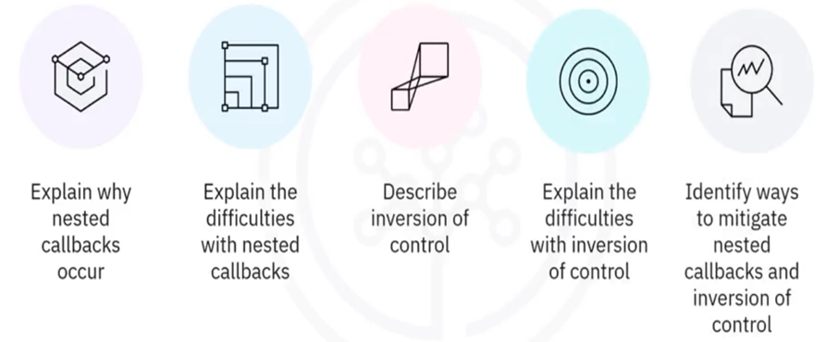
What you will learn

Slide 3

Callback functions
• A function passed as an argument
to another function
• Used to ensure an action is
executed only after a result is
produced

Slide 4
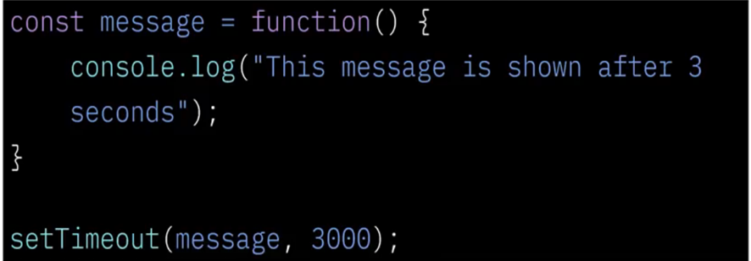
Callback example

Slide 5
Retrieval and execution
Databases
callback()
Images
Read file

Slide 6
Sequential steps
Making a cake:
Purchase ingredients
Combine ingredients
Bake
Decorate
Serve

Slide 7
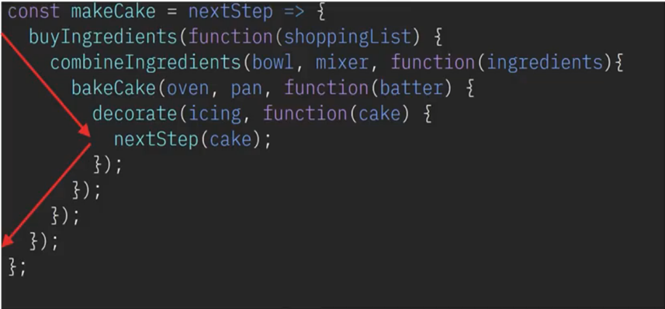
Function nesting

Slide 8
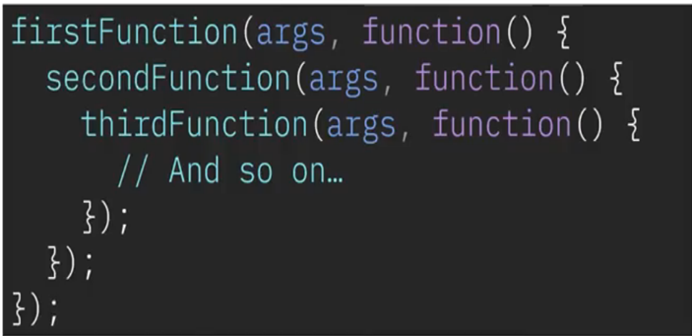
"Callback hell"

Slide 9
Inversion of control (IOC)
• Execution is external to your code
• Callbacks hand over control to a third-party service
• That code may have errors
• Causes you to write additional code
• Ensure third-party code does not:
• Get called too many or too few times
• Get called too early or too late
• Lose context
• Pass back incorrect arguments

Slide 10
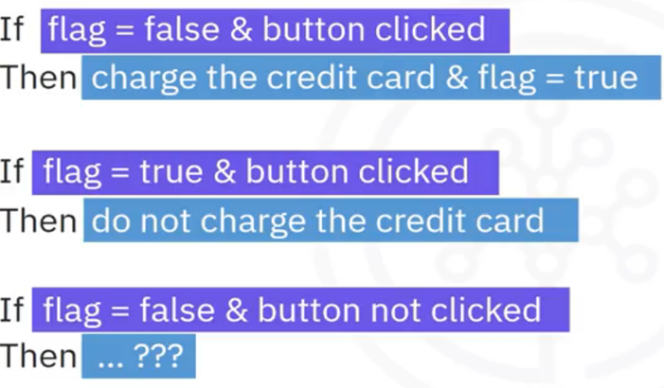
IOC complications example

Slide 11
Ways to mitigate
• Write comments
• Split functions into smaller functions
• Use promises
• Use async/await

Slide 12
Recap
In this video, you learned that:
• The need for nested callback functions can occur when several of the
callback tasks are dependent on each other and need to be
completed sequentially
• The term "callback hell" refers to nested callback functions
• When using third-party code you often have inversion of control
issues where you cannot trust the third-party code
• Ways to mitigate callback hell and trust issues include writing
comments, splitting functions into smaller functions, using promises,
and using async/await

